Slide 1
Smart Low-Light Image Enhancement For Emotion Detection
TEAM MEMBERS-
Y.SUDHEER BABU - 9921005181
P.SASI VARDHAN REDDY - 9921005312
N.TEJA - 9921005199
P.JAGAN MOHAN REDDY - 9921005222

Slide 2
CONTENT
OBJECTIVE
ABSTRACT
INTRODUCTION
LITERATURE SURVEY
BLOCK DIAGRAM
PROBLEM STATEMENT
SOFTWARE USED
APPLICATIONS
METHODOLOGY
CONCLUSION
REFERENCES

Slide 3
OBJECTIVE
The main objective of the facial expression intelligence project is to develop a system that can accurately detect and recognize human emotions from facial expressions.
1. Emotion recognition for mental health diagnosis and monitoring.
2. Sentiment analysis for market research and customer feedback.
3. Emotion-based personalization for advertising and entertainment.
4. Emotion detection for security and surveillance purposes.

Slide 4
ABSTRACT
This project is focused on developing an facial expression intelligence system able to detect and read human emotions from facial expressions.
Our designed system is capable of identifying and classifying emotions, such as happiness, sadness, anger, surprise, among others, using computer vision techniques and machine learning tools with a high accuracy rating.
Our approach fuses convolutional neural networks with transfer learning for state-of-the-art performance on publicly available datasets of emotion detection. The system will be very useful in several industries and domains by enhancing the emotional intelligence and empathy of human-machine interaction.

Slide 5
INTRODUCTION
Emotion detection plays a crucial role in various applications, including human-computer interaction, security, healthcare, and social robotics. Accurately detecting emotions can improve user experience, enhance communication, and provide critical insights into human behavior.
Images captured in low-light environments often suffer from poor visibility, noise, and color distortions. These challenges make it difficult for traditional emotion detection algorithms to perform accurately, as the quality of facial features is significantly degraded.
By integrating smart low-light image enhancement with emotion detection systems, it becomes possible to maintain high accuracy in various lighting conditions. Enhanced images provide clearer facial features, which are critical for distinguishing subtle emotional expressions.
Effective low-light enhancement for emotion detection has significant implications for real-world applications, such as night-time surveillance, virtual reality, and assistive technologies for the visually impaired. This research contributes to building more robust and adaptable emotion detection systems that perform reliably under challenging lighting conditions.

Slide 6
LITERATURE SURVEY
Sno | Authors | Journal & Year | Title of the paper | Methodology
1 | yihua fan, dong liang, yiping chen | Nanjing,china in 2022 | low-facenet: face recognition –driven low-light image enhancement | To enhance low-light images for face recognition, first improve image visibility using techniques such as histogram equalization. Then, preprocess the enhanced images (resize and normalize) and extract facial embeddings using a model like FaceNet or VGG-Face. Finally, calculate the Euclidean distance between embeddings to determine if the faces are from the same person, comparing this distance to a predefined threshold to assess similarity.
2 | Nisha Raichur, Nidhi Lonakadi, Priyanka Mural | International Journal of Engineering and Technology, vol.9, no. 3S, July 2017. | Detection of Stress Using Image Processing and Machine Learning Techniques | Stress is a part of life it is an unpleasant state of emotional arousal that people experience in situations like working for long hours in front of computer. Computers have become a way of life, much life is spent on the computers and hence we are therefore more affected by the ups and downs that they cause us. One cannot just completely avoid their work on computers but one can at least control his/her usage when being alarmed about him being stressed at certain point of time. Monitoring the emotional status of a person who is working in front of a computer for longer duration is crucial for the safety of a person. In this work a real-time non-intrusive videos are captured, which detects the emotional status of a person by analysing the facial expression. We detect an individual emotion in each video frame and the decision on the stress level is made in sequential hours of the video captured. We employ a technique that allows us to train a model and analyze differences in predicting the features. Theano is a python framework which aims at improving both the execution time and development time of the linear regression model which is used here as a deep learning algorithm. The experimental results show that the developed system is well on data with the generic model of all ages.

Slide 7
Sno | Authors | Journal & Year | Title of the paper | Methodology
3 | D. K. Yashaswini, Sachin S. Bhat, Y. S. Sahana, M S. Shama Adiga, Shashank G. Dhanya | International Journal of Research in Engineering, Science and Management Volume-2, Issue-8, August-2019 | Stress Detection using Deep Learning and IoT | Stress is a part of life which is an unpleasant emotional state that people experience in situations like working for long hours in front of a computer. Stress can be positive, but it can affect your health if it's chronic. Thus, it is very much necessary to inform the person about his/her unhealthy lifestyle and even alarm him/her before any acute condition occurs. To detect the stress beforehand, a Deep Learning (DL) method is used where real-time images are captured, which detects the emotional status of a person by analyzing the facial expression and Internet of Things (IoT) is used to inform the patients about his/her stress condition.
4 | MS.N.Pavani,Associate Professor,P.Supriya, A.SiriChandana, B.Trinetra, S.V.N.S.S.Supriya. | UGC Care Group I Journal ISSN : 2347-7180 Vol-08 Issue-14 No. 02: 2021 | Stress detection using image processing and machine learning. | The main motive of our project is to detect stress in the IT professionals using theatrical Machine learning and Image processing techniques. Our system is an enhanced version of the old stress detection systems thatkeep outlive detection and personal counseling. The system supports live detectionand regular analysis of employees. It detects both physical and mental stress levels and furnishes proper remedies by providing survey forms systematically. Our system mainly preventative measures that can help focuses on managing stress and you cope with it.

Slide 8
Sno | Authors | Journal & Year | Title of the paper | Methodology
5 | Zhijian Luo, Jiahui Tang, Yueen Hou, Zihan Huang and Yanzeng Gao | School of Computer, Jiaying University, Meizhou, R. P. China, 514015 ,27-07-2023 | Unsupervised Low Light Image Enhancement via SNR-Aware Swin Transformer | Image captured under low-light conditions presents unpleasing artifacts, which debilitate the performance of feature extraction for many upstream visual tasks. Low-light image enhancement aims at improving brightness and contrast, and further reducing noise that corrupts the visual quality. Recently, many image restoration methods based on Swin Transformer have been proposed and achieve impressive performance. However, on one hand, trivially employing Swin Transformer for lowlight image enhancement would expose some artifacts, including over-exposure, brightness imbalance and noise corruption, etc. On the other hand, it is impractical to capture image pairs of low-light images and corresponding ground-truth, i.e. wellexposed image in same visual scene. In this paper, we propose a dual-branch network based on Swin Transformer, guided by a signal-to-noise ratio prior map which provides the spatialvarying information for low-light image enhancement.
6 | shakil0304003 | 20-09-2010 | Human Emotion Detection From image | Human emotion detection from images involves preprocessing and resizing the image, detecting the face, extracting facial features using a deep learning model, and classifying the detected emotions using a specialized emotion classification model. The final step is mapping the model's predictions to specific emotions.

Slide 9

BlOCK DIAGRAM
OUTPUT
Hold-Out cross
validation
ANGER
MODEL
Training
CONTEMPT
CNN
Data
collections
Data
Augmentation
DISGUST
VIT
Test
FEAR
VGG
HAPPY
INCEPTION
Validation
SADNESS

Slide 10
PROBLEM STATEMENT
The performance of emotion detection systems significantly declines in low-light conditions due to poor image quality, including noise, low contrast, and loss of facial details critical for accurate recognition. Existing image enhancement techniques are not specifically optimized for emotion detection, leading to inadequate results when applied to low-light images. This research aims to develop a smart low-light image enhancement framework tailored for emotion detection, enhancing image visibility and preserving essential facial features to ensure high accuracy and reliability across varying lighting conditions. The goal is to bridge the gap between low-light image quality and the requirements of robust emotion recognition systems.

Slide 11
Software used
Primary Software for Emotion Detection: DeepFace is the key software library in your code for performing emotion analysis.
Supporting Libraries: cv2, mediapipe, and numpy are included for potential use in image handling and processing but aren't directly utilized in the shown code.
VLS CODE
ALGORITHMS:
Face Detection: MTCNNE motion
Recognition Model: FER (CNN-based model)
Classification Method: Softmax classifier to determine the emotion label.

Slide 12
Applications
Human-Computer Interaction (HCI)
Enhancing user experiences based on emotional feedback.-
Customer Service
Analyzing customer satisfaction and reactions in real-time
Mental Health Monitoring
Detecting signs of distress or negative emotions.

Slide 13
METHODOLOGY
Developing a facial expression intelligence system for emotion detection involves data collection, facial landmark detection, feature extraction, emotion classification, real-time processing, and user interface development. It also emphasizes privacy and security considerations, and continuous evaluation for system improvement. By following this structured approach, the system aims to provide accurate, real-time emotion detection and enhance user interactions across various applications.

Slide 14
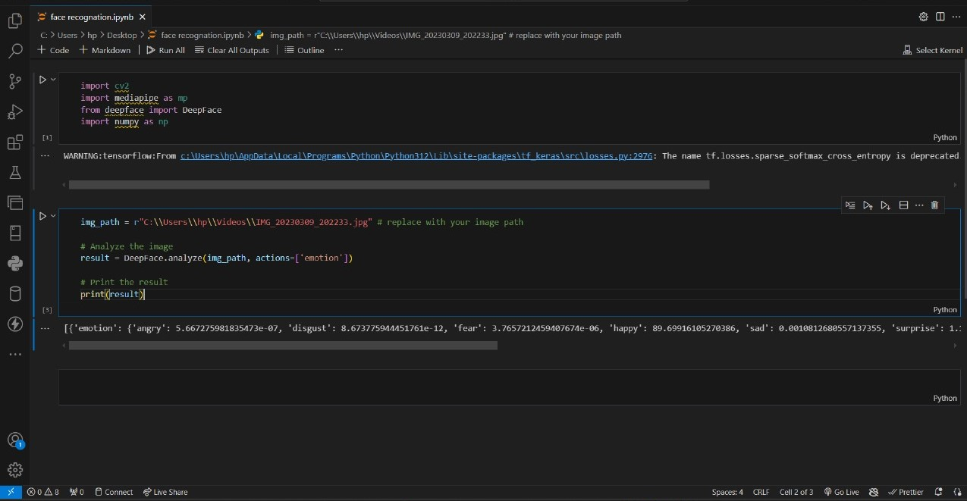

Slide 15
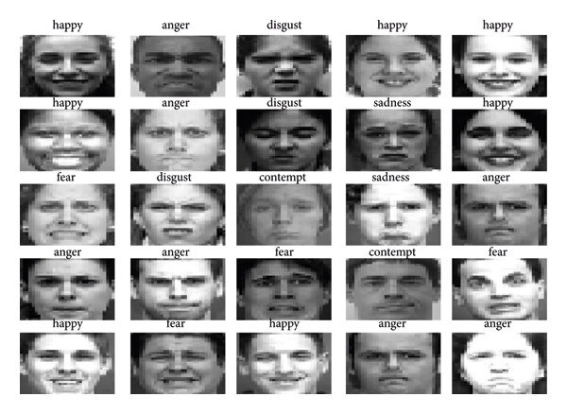
FACIAL EXPRESSIONS

Slide 16
CONCLUSION
This facial expression recognition system that accurately detects emotions like happiness, sadness, and anger. It uses AI and machine learning to analyze facial features and classify emotions. The technology has many potential applications and can be improved further to enhance real-time performance and address individual variations.
”Smart Low-Light Image Enhancement for Emotion Detection" is a project that aims to develop an AI-powered system to enhance low-light images and improve emotion detection accuracy. The system uses advanced image processing techniques to enhance facial features and illumination, allowing for more accurate emotion recognition. By improving image quality, the system enables more reliable emotion detection in various applications, including healthcare, security, and human-computer interaction.

Slide 17
References
[1] G. Giannakakis, D. Manousos, F. Chiarugi, “Stress and anxiety detection using facial cues from videos,” Biomedical Signal processing and Control”, vol. 31, pp. 89- 101, January 2017.
[2] Nisha Raichur, Nidhi Lonakadi, Priyanka Mural, “Detection of Stress Using Image Processing and Machine Learning Techniques”, vol.9, no. 3S, July 2017.
[3] U. S. Reddy, A. V. Thota and A. Dharun, "Machine Learning Techniques for Stress Prediction in Working Employees," 2018 IEEE International Conference on Computational Intelligence and Computing Research (ICCIC), Madurai, India, 2018, pp. 1-4.
[4] T. Jick and R. Payne, “Stress at work,” Journal of Management Education, vol. 5, no. 3, pp. 50-56, 1980.
[5] Bhattacharyya, R., & Basu, S. (2018). Retrieved from ‘The Economic Times’.
[6] OSMI Mental Health in Tech Survey Dataset, 2017
[7] https://www.kaggle.com/qiriro/stress www.jespublication.com Page 1002Journal of Engineering Sciences Vol 13 Issue 07,2022, ISSN:0377-9254

Slide 18
[8] Communications, N.. World health report. 2001.URL:http://www.who.int/whr/2001/media _centre/press_release/ en/.
[9] Liu, D., Ulrich, M.. Listen to your heart: Stress prediction using consumer heart rate sensors 2015;.
[10] Bakker, J., Holenderski, L., Kocielnik, R., Pechenizkiy, M., Sidorova, N.. Stess@ work: From measuring stress to its understanding, prediction and handling with personalized coaching. In: Proceedings of the 2nd ACM SIGHIT International health informatics symposium. ACM; 2012, p. 673–678.
[11] Deng, Y., Wu, Z., Chu, C.H., Zhang, Q., Hsu, D.F.. Sensor feature selection and combination for stress identification using combinatorial fusion. International Journal of Advanced Robotic Systems 2013;10(8):306.
[12] Ghaderi, A., Frounchi, J., Farnam, A.. Machine learning-based signal processing using physiological signals for stress detection. In: 2015 22nd Iranian Conference on Biomedical Engineering (ICBME). 2015, p. 93–98.
[13] Villarejo, M.V., Zapirain, B.G., Zorrilla, A.M.. A stress sensor based on galvanic skin response (gsr) controlled by zigbee. Sensors 2012; 12(5):6075– 6101.

Slide 19
[14] Nakashima, Y., Kim, J., Flutura, S., Seiderer, A., Andre, E.. Stress recognition in daily work. In: ´ International Symposium on Pervasive Computing Paradigms for Mental Health. Springer; 2015, p. 23– 33.
[15] Xu, Q., Nwe, T.L., Guan, C.. Cluster-based analysis for personalized stress evaluation using physiological signals. biomedical and 2015;19(1):275–281. IEEE health journal of informatics www.jespublication.com

